Slide 1
Transition to Senior School Evening
Wednesday 8 May 2019

Slide 2
Agenda
Alastair Thomas – Headmaster
Welcome and Introduction
Varun Footring – Assistant Head Welfare Royal Russell School, Deputy Head Pastoral at The Manor from September 2019
Victoria Evans – Head of Years 5 and 6, Deputy Head Academic at The Manor from September 2019
Process and Timings
What To Expect
Pastoral Care for Children... and Parents
Neil Jackson – Head of Years 5 and 6 at The Manor from September 2019
Andrew Hall - Deputy Head at Dean Close
Social Media

Slide 3
Open Events 2019
Cranford House: Personal tours and taster days by appointment
Cokethorpe: Saturday 18 May, 9.30-12.00
d’Overbroeck’s: Saturday 11 May, 10.00-13.00
Downe House: Saturday 15 June
Headington: Thursday 27 June 10.00-12.30
Saturday 5 October
Larkmead School: Thursday 4 July
Matthew Arnold School: Thursday 3 October
Our Lady’s Abingdon: Tuesday 18 June
Saturday 12 October
Oxford High School: Wednesday 19 June
Pangbourne College: Saturday 21 September
Queen Anne’s School: Saturday 11 May, 9.30
Thursday 13 June 16.30-18.30
Saturday 14 September, 9.30
Rye St Antony: Saturday 18 May, 10.00-12.30
St Helen & St Katharine: Headmistress’ Breakfast - Thursday 13 June
Open Morning - Saturday 28 September
Tudor Hall: Saturday 11 May
Wychwood: No dates currently advertised
NB: Please check individual school websites for the most up to date information and to find out which events need to be booked in advance.

Slide 4
Timeline: November Y5 to July Y6
Senior Schools Open Events
November: Year 5 Parents’ Evening Core Subjects
March: Year 5 Reports
May: Transition to Senior School Evening
June: Year 5 Parents’ Evening (all subjects)
Summer Holidays:
Holiday work - English, Maths and Science
September: Weekly Mailing
‘Guide to Senior School Applications’
From October: Senior School Applications Close
October/November: Year 6 Parents’ Evening
November – January:
Entrance Exams, Interviews and Taster Days
December: Year 6 Reports
March: Destination Schools Finalised
May/July: Induction Days and visits from Senior School staff

Slide 5
Weekly Mailings
Weekly Mailing - Friday 13 September 2019
‘Guide to Senior School Applications and Key Dates’ Letter including online reply slip relating to Common Entrance (which is used for some boarding schools)
‘Possible Schools at 11+ Booklet’*
‘Request for Extra-Curricular Activities Information’ Letter including online reply slip
* 2018-2019 Publication is currently on The Manor website/Parents/Next Schools

Slide 6
Weekly Mailings
Weekly Mailing - Friday 20 September 2019
‘Confirmation of Applications to Senior Schools’ Letter and online reply slip
Weekly Mailing - Friday 6 March 2020
‘Confirmation of Destination Senior School’ Letter and online reply slip

Slide 7
What To Expect
Summer Holiday work
Regular practice in school of all of the elements of the examinations
Information on the Weekly Mailings
Low key approach from school around the exams themselves and the results
Tired children
Children’s approach

Slide 8
Pastoral Care for the Children
Teamwork between the adults involved
Support from home and school with the work – effort and achievement
Support from home and school with friendship issues and the idea of future changes
Encourage routine/normality
Maintain exercise and interests
Facilitate early nights and healthy diet
Screen Time Discipline

Slide 9
Pastoral Care for Parents!
Full details of process
Head’s PA Nicole Burroughs
Reports and Parents’ Evenings
Head of Y5 and Y6, Y6 Form Teachers, Deputy Heads and Headmaster
Fellow Parents

Slide 10
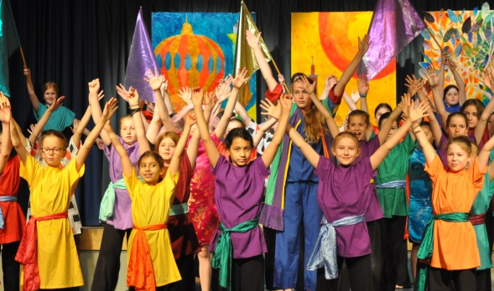
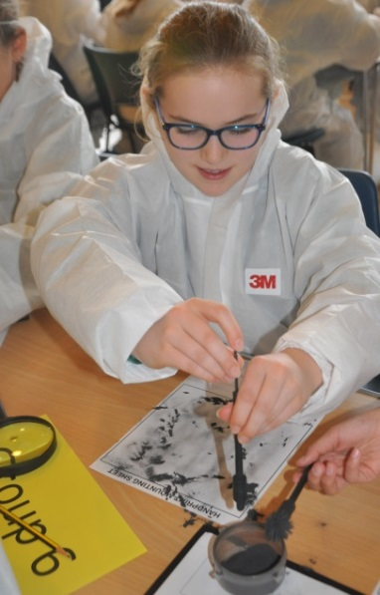
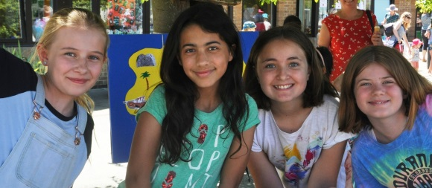
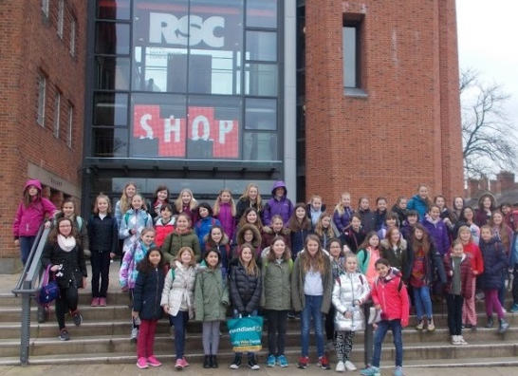
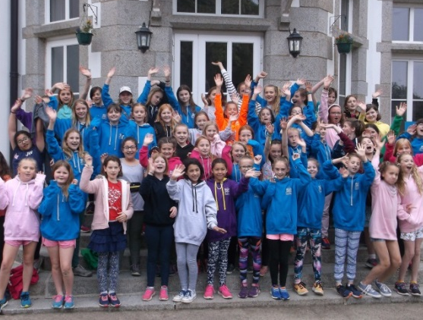
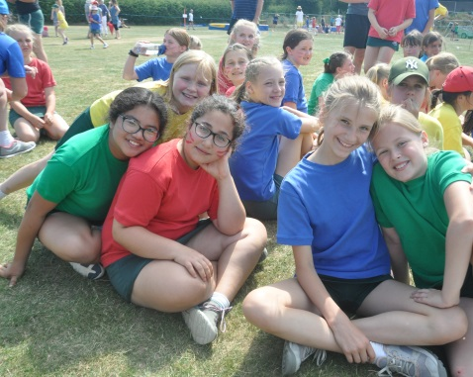
Life After Entrance Exams!
Continued Curriculum Work
Assessments
Latin
Financial Talk
Induction Days
Visits from Senior School Staff to The Manor to meet our children

Slide 11
Transition to Senior School Evening
Wednesday 8 May 2019

