Slide 1
Transition to Senior School Presentation
Wednesday 20 May 2020

Slide 2
Agenda
Mr Alastair Thomas – Headmaster
Welcome and Introduction
Mrs Victoria Evans – Deputy Head Academic
Process and Timings
What To Expect
Mr Varun Footring – Deputy Head Pastoral
Pastoral Care for Children... and Parents

Slide 3
Virtual Open Events / Meetings 2020
Abingdon School: Wednesday 20 May 2020, 9.30-10.30am OR private appointments by phone/video
https://www.abingdon.org.uk/admissions/visit-abingdon/
Cranford House: admissions@cranfordhouse.net / 01491 651218
Cokethorpe: admissions@cokethorpe.org / 01993 892333
Didcot Girls’ School: head.4139@didcotgirls.oxon.sch.uk / 01235 812 092
d’Overbroeck’s: Tuesday 9 June and Wednesday 10 June, 12:00pm
https://www.doverbroecks.com/home/open-day/
Downe House: registrar@downehouse.net / 01635 200286
Headington: admissions@headington.org / 01865 759100
Larkmead School: office.4125@larkmead.oxon.sch.uk / 01235 520141
Magdalen College School: Tuesday 23rd June 2020, 2.30pm OR book a call with Registrar, Mrs Barberine Mallett
https://www.mcsoxford.org/admissions/open-days/book-an-open-day/
Matthew Arnold School: admissions.schools@oxfordshire.gov.uk / 01865 862232
Our Lady’s Abingdon: On request: www.olab.org.uk/ola-virtual-open-morning-registration
Oxford High School: On request: oxfordhigh.gdst.net/admissions/visit-us/senior-and-sixth-form-virtual-meeting/
Pangbourne College: On request: https://www.pangbourne.com/prospective-families/admissions/visit-us
Queen Anne’s School: On request: https://www.qas.org.uk/admissions/entry-guide
Rye St Antony: Friday 22 May and Saturday 13 June, 10.00am
https://www.ryestantony.co.uk/448/admissions/open-mornings
St Birinus: stbirinus@st-birinus.oxon.sch.uk / 01235 814444
St Helen & St Katharine: Tuesday 12 May and Friday 19 June, 9.10am OR remote individual visits https://www.shsk.org.uk/admissions/Open-day.aspx
The Oratory School: On request: registrar@oratory.co.uk / 01491 683522
Tudor Hall: admissions@tudorhallschool.com / 01295 263434
Wychwood: admissions@wychwoodschool.org / 01865 557 976
NB: Correct on 12/05/2020. Please check individual school websites for the most up to date information

Slide 4
Timeline: November Year 5 to July Year 6
Senior Schools Open Events
November: Year 5 Parents’ Evening Core Subjects
March: Year 5 Reports
May: Transition to Senior School Evening
June: Opportunity to discuss senior schools with Mr Thomas
July: Year 5 Core Subject Reports
Summer Holidays:
Holiday work - English, Maths and Science
September: Weekly Mailing
‘Guide to Senior School Applications’
From October: Senior School Applications Close
October/November: Year 6 Parents’ Evening
November – January:
Entrance Exams, Interviews and Taster Days
December: Year 6 Reports
March: Destination Schools Finalised
May/July: Induction Days and visits from Senior School staff

Slide 5
Weekly Mailings
Weekly Mailing - Friday 11 September 2020
‘Guide to Senior School Applications and Key Dates’ Letter including online reply slip relating to Common Entrance (which is used for some boarding schools)
‘Possible Schools at 11+ Booklet’*
‘Request for Extra-Curricular Activities Information’ Letter including online reply slip
* 2019-2020 Publication is currently on The Manor website (Admissions/ Academic Results, Scholarships and Future Schools)

Slide 6
Weekly Mailings
Weekly Mailing - Friday 18 September 2020
‘Confirmation of Applications to Senior Schools’ Letter and online reply slip
Weekly Mailing - Friday 5 March 2021
‘Confirmation of Destination Senior School’ Letter and online reply slip

Slide 7
What To Expect
Summer Holiday work
Regular practice in school of all of the elements of the examinations
Enrichment
Information on the Weekly Mailings
Low key approach from school around the exams themselves and the results
Tired children
Children’s approach

Slide 8
Pastoral Care for the Children
Teamwork between the adults involved
Support from home and school with the work – effort and achievement
Support from home and school with friendship issues and the idea of future changes
Encourage routine/normality
Maintain exercise and interests
Facilitate early nights and healthy diet
Screen Time Discipline
Mindfulness

Slide 9
Pastoral Care for Parents!
Full details of process
Head’s PA Nicole Burroughs
Reports and Parents’ Evenings
Fellow parents
Head of Y5 and Y6, Y6 Form Teachers, Deputy Heads and Headmaster

Slide 10
Key Contacts
Alastair Thomas, Headmaster – 01235 858460 / 07552 842864
head@manorprep.org
Victoria Evans, Deputy Head Academic – 01235 858496 / 07552 846591
vevans@manorprep.org
Varun Footring, Deputy Head Pastoral – 01235 858480 / 07983 400129
vfootring@manorprep.org
Neil Jackson, Head of Year 5 and 6 – 01235 858453
njackson@manorprep.org
Nicole Burroughs, PA to the Headmaster – 01235 858479
headspa@manorprep.org

Slide 11
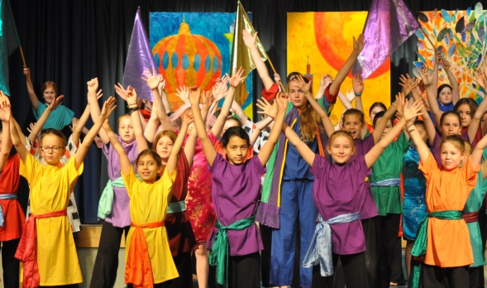
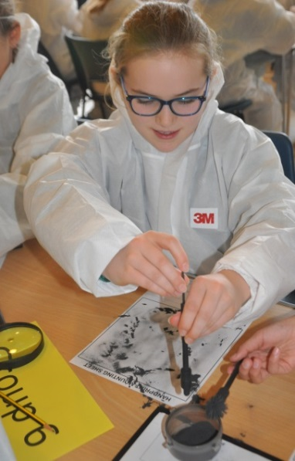
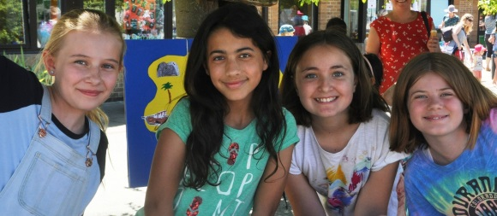
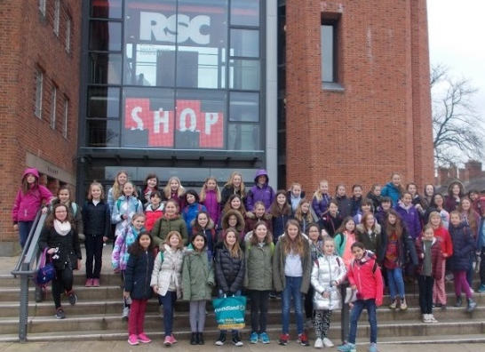
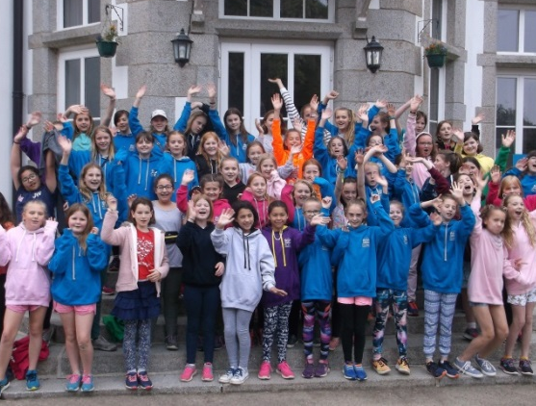
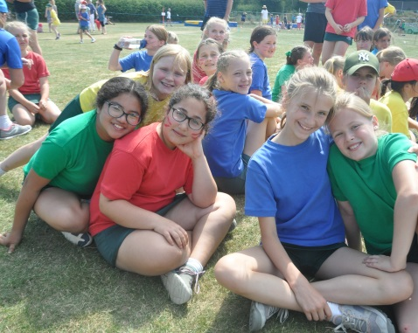
Life After Entrance Exams!
Continued Curriculum Work
Assessments
Latin
Enrichment Presentations
Induction Days
Visits from Senior School Staff to The Manor to
meet our children

Slide 12
FAQs
Q – Who do I approach to get permission to visit other schools (Open Days, Taster Days etc)?
A – These requests should go by email to Form Teachers, please.
Q – How many schools should my child apply to?
A – This varies from child to child and we would suggest you discuss this in person with Mr Thomas.
Q – Which schools use ISEB Common Entrance?
A – A small number of boarding schools use ISEB Common Entrance as all or part of their entry procedure. A list of these schools will be included in the ‘Possible Schools at 11+’ booklet which we will publish in September 2020.
Q – When and how is my child’s senior school reference written and sent?
A – We prepare a confidential Headmaster’s Report for every child between September and November of Year 6. These are sent out as and when requested by Senior Schools and no later than the end of November. We use our own established and well-regarded template for these Reports. The Report is contributed to by all subject teachers and also includes a section on Extra-Curricular activities.
Q – Should my child practise for interviews?
A – Senior Schools tend to prefer that children are not prepped for interview. At this age, the interviews are a general chat and very informal. The most important elements are eye contact and a big smile!
Q – What is the deadline for senior schools applications?
A – The is varies from school to school, but for the vast majority of day schools in our area, the registration deadline is in October of Year 6.
Q – How long after a senior schools entrance exam will we find out the result?
A – In most cases results will be published no more than two weeks after the entrance exam.

